Slide 1
Banding in Employee Selection
Lonnisa Skinner and William Eddy
Notes:
Our presentation today is on a technique in employee selection called “banding.”
So in this presentation we’re going to go over:
What is it
When do you use it (and when don’t you use it)
Why do you use it
And
How is it done
We’ve got an exercise so you can get your hands dirty
And I want to start by apologizing - there are no fun Youtube videos on Banding in employee selection - not that we’ve found anyway, and boy did we look!

Slide 2
Ways to utilize results of an assessment:
Top-down selection
Highest probability of having the best results
Linear relationship between scores:
“Classical theory of selection”
Cutoff scores
All scores above the cutoff are considered equal
Banding
Notes:
We’ll start with a quick summary of the 3 main ways to utilize a test score
Top-down selection usually leads to the best work performance, so it is our default selection procedure for utilizing assessments. For top-down, we simply go down the list, starting by hiring the candidate with the highest score on our predictive and validated measure. (READ SLIDE)
With strict application of cutoff scores, we treat all candidates who score above a given score as the same.
Selection procedures may use a combination of these two - top-down and cutoff.
But, depending on the assessment being used, top-down and cutoff scores can and often do produce adverse impact.
Once you find that a selection procedure is causing adverse impact, banding allows us to utilize a great assessment, while
Recognizing that error is inherent in assessment results
Addressing adverse impact effects a tool created, while continuing to use that tool

Slide 3
Assessments and adverse impact
Measuring General Mental Ability (G)
Top-down selection first
Economic effects and adverse impact on minorities
Race norming - an illegal solution
Banding - a legal solution
Notes:
Mental ability tests - an excellent predictor of work performance.
We default to top-down utilization - the highest scorer is selected first, and on down the line.
BUT
Systematic economic effects imposed on racial minorities have resulted in reduced G scores compared with non-minorities
One past solution - Adjusting scores via “race norming.” This was made illegal by the Civil Rights Act of 1991.
What exactly is race norming?
Members of a protected group have their scores adjusted systematically to combat an assessment adverse impact. Different protected groups receive different adjustments.
CRA 1991 prohibits Race Norming
Banding is allowed legally. We will go into detail about what it is.

Slide 4

When to implement banding
As a last resort
Lose a lawsuit: Consent decree and Court order
Organization required to fix systematic problem
Federal contractors likely to plan for the worst
Still not likely to plan for banding
Notes:
While some creative researchers have proposed other applications, for our purposes we are considering banding as an affirmative action solution.
Banding is not used as part of a normal selection procedure. It is not wise to use it voluntarily Because it is by definition discrimination, and using it voluntarily opens you to liability
Banding is a solution to a problem in a company when a lawsuit has been lost saying the selection systems have discriminated
It is to be used to implement affirmative action only

Slide 5
Origin of banding
Chicago firefighters found adverse impact in hiring procedures
All white
Chicago is diverse
Banding examined by Casico et al as solution
Casico et al (1991)

Slide 6
Cascio et al (1991)
Top down referral method and 5 variations on banding. Found differences in:
Percentage of minority vs nonminority chosen
Levels of adverse impact relative to the hiring pool
Top down has best economic utility
To optimize social and economic simultaneously:
Sliding band with diversity based selection within bands.
Notes:
Cascio et al (1991) is one of the foundational papers on applying banding as an affirmative action tool.
The paper compares the gold standard - top down banding - with several variations of banding procedures.

Slide 7
Banding: What and Why

Slide 8
What is banding?
Grouping test scores into ranges
Treating scores within a range as equivalent
Utilizes inaccuracy of a useful measure
Notes:
Definition from the textbook on page 230: (READ THIS OUT LOUD)
“Banding involves establishing ranges of selection procedure scores where applicants’ scores within a range or band are treated the same. Within a band, any selection procedure score differences are seen as due to measurement error and thus equivalent. The rationale behind banding is that scores on selection procedures do not have perfect reliability and, therefore, these scores do not perfectly reflect individuals’ true scores on the characteristic measured by the selection procedure. Because small differences among applicants’ scores on a selection procedure are due to measurement errors (that is, selection procedure score unreliability), these differences are not meaningful.”

Slide 9
Why does banding work?
A test has inaccuracy we can measure: error
Scores can be too close to distinguish
Within this range, scores should be treated as equivalent
Notes:
Draw a diagram on the board
Or make one for a visual here to reference.

Slide 10
The Mathematics of Banding:
Two Techniques

Slide 11



Calculate SEM
Standard Error of Measurement is calculated using the following equation:
Where is the standard deviation of the measure
And
is the reliability of the measure

Slide 12
Standard error of measurement method
SEM calculated for the test / predictor
Band width = SEM * 1.96
1.96 represents: 95% confidence interval (use the CI you want)
Subtract the band width from the top score -> First band
Notes:
SEM Calculated for the test / predictor
SEM * 1.96 (95%CI). = band width
If we wanted confidence interval, we would use +/- the band width, but because we are combining this with a top-down approach, we only need to subtract
“then the product is subtracted from an applicant’s selection procedure score. This results in a range of scores that are basically equivalent 95 percent of the time. For example, assume that the standard error of measurement (SEM) is equal to 2.98. Multiplying 2.98 by 1.96 gives a product of 5.84. If the top applicant score on the predictor is 95, subtracting 5.84 results in a score of 89.16. Thus applicants’ predictor scores between 89.16 and 95 are not significantly different and are considered equivalent.” (GFB pg 231)

Slide 13
Standard error of differences method
More often mentioned in literature
Band width = SEM * 1.414 * 1.96
1.414 = √2 represents:
Standard deviation of difference between 2 independent scores
1.96 represents: 95% confidence interval
Subtract the band width from the top score -> First band
Notes:
According to the textbook, the standard error of differences method is discussed more often in the literature.
This method results in a larger band, which might be a problem for face validity.
Low face validity can open the organization to legal challenges
We will touch on this later.

Slide 14
Fixed vs. Sliding Bands
Fixed Banding
Create a band by subtracting band width from the top applicant score
Using the resulting band, applicants are selected from within the band until all of the positions are filled OR the band has been exhausted
If the band is exhausted, a second band is created starting with the highest score outside of the first band
Continue until all positions are filled or there are no remaining applicants
Sliding Bands
Create a band by subtracting band width from the top applicant score
Select all applicants within band who fit the desired status first, followed by top-down selection
As soon as the top score has been selected, the band slides down to include the next highest score as a new starting point
This now includes the scores that were just outside of the band
The band can also shift depending on a secondary criteria (i.e., minority group status)
Continue until all positions are filled

Slide 15
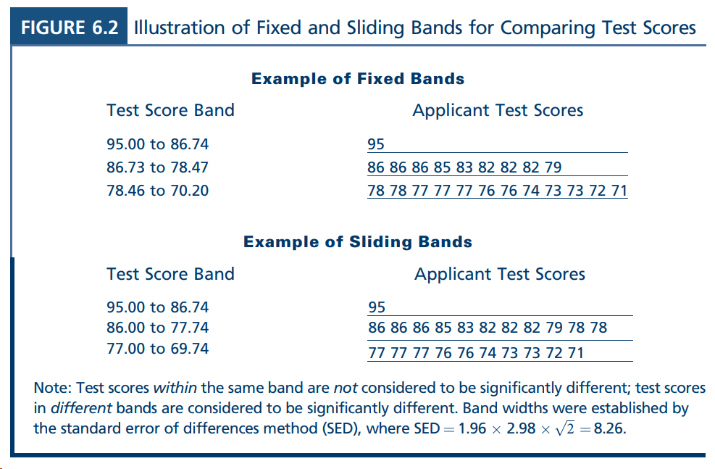
Notes:
Fixed - Uses top applicant score as first starting point. Subtract band width. This is top band.
Highest remaining score outside first band used as next starting point.
For each band, select using other criteria outside banded assessment in question.
Sliding
Calculate band for top applicant as in Fixed. Conduct first selection.
Calculate second band based on second highest score, including scores within first band.
Advantage - with Fixed we lose applicants, but sliding allows us to choose from all applicants.
DO EXERCISE NOW

Slide 16
Fixed vs Sliding - which to use?
Fixed bands
Assures that candidates are selected from one list with consistent standards
Allows for selection of minority group applicants at a faster rate than strict top-down selection method
Tends to eliminate many qualified applicants by constricting movement of the band until the band is exhausted
Sliding bands
Allow selection from pools of candidates with higher scores
According to Cascio et al (1991), sliding bands are better
Does not assume identical qualification between individuals within a band
Allows for inclusion of greater numbers of minority group applicants in the workforce at a faster rate than fixed banding or strict top-down selection methods
Can eliminate adverse impact in terms of the actual selection of candidates
Overall, it allows for more flexibility in selection

Slide 17
Selection Within a Band

Slide 18
Selecting within a band
Must choose a procedure for selecting and stick to it
Once bands have been created, use other selection specifications in choosing between individuals within the same band
E.g. job experience, training, work habits, etc.
Typically, protected group status is not utilized in selection unless legally mandated
As to avoid disparate treatment
Notes:
Any predictor used here can not be used earlier in the selection procedure.
Therefore, by necessity, these are less powerful predictors.
because the more powerful selection procedures have already been used.
Book recommends to employ multiple regression to measure predictive effect of within-band selection factors to choose which to use and how to weight them.

Slide 19
Results of Banding Procedures

Slide 20
Banding and Effect on Adverse Impact
“Wayne Cascio and his colleagues concluded that using banding has generally yielded modest reductions in adverse impact with little negative effects on selection procedure validity or utility. However, banding is not the final answer to the problem of adverse impact of selection procedures.” GFB pg 234

Slide 21
Banding: Face value of hiring procedures
Banding is difficult to explain
When there are higher scores,, but a lower scoring applicant is chosen
Negative reactions possible
Dependent on opinions towards affirmative action
Schmidt argues that the basic principle of developing bands is not consistent in banding

Slide 22
Banding: Concluding remarks

Slide 23
Concluding statements
Avoid banding without legal mandate
Court order and consent decree
Don’t get too many fancy ideas here. Banding has a specific application.
Consider face validity
Banding is really cool - but potentially problematic if not utilized properly

